Slide 1

Quantum Fourier Transform on a Penning Trapped Ion Architecture
Team: qurious not serious
Authors: Nessim Dridi, Kemal Önen, Maximilian Spitaler, Arne Geipel
ETH Quantum Hackathon 2025

Slide 2
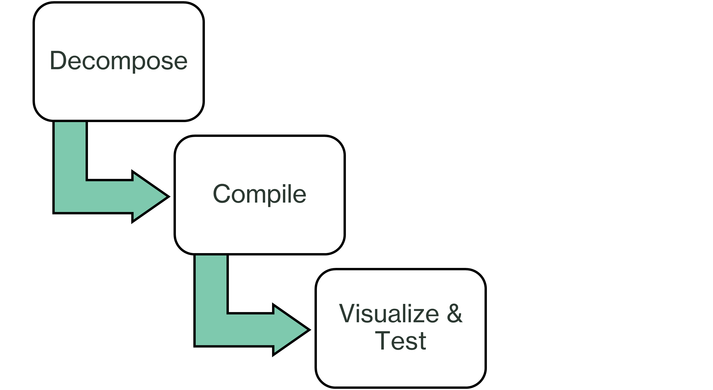
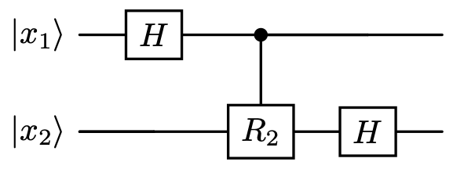
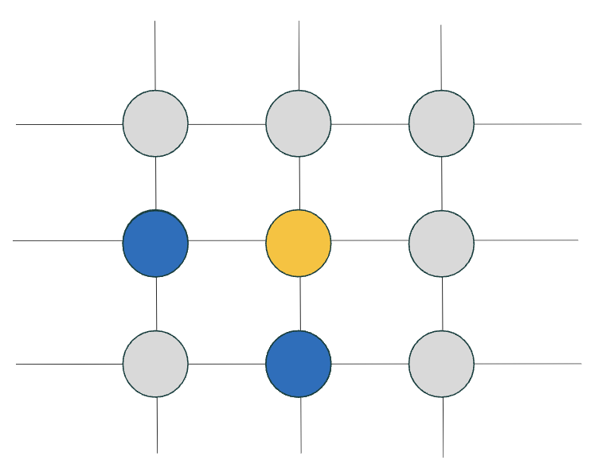
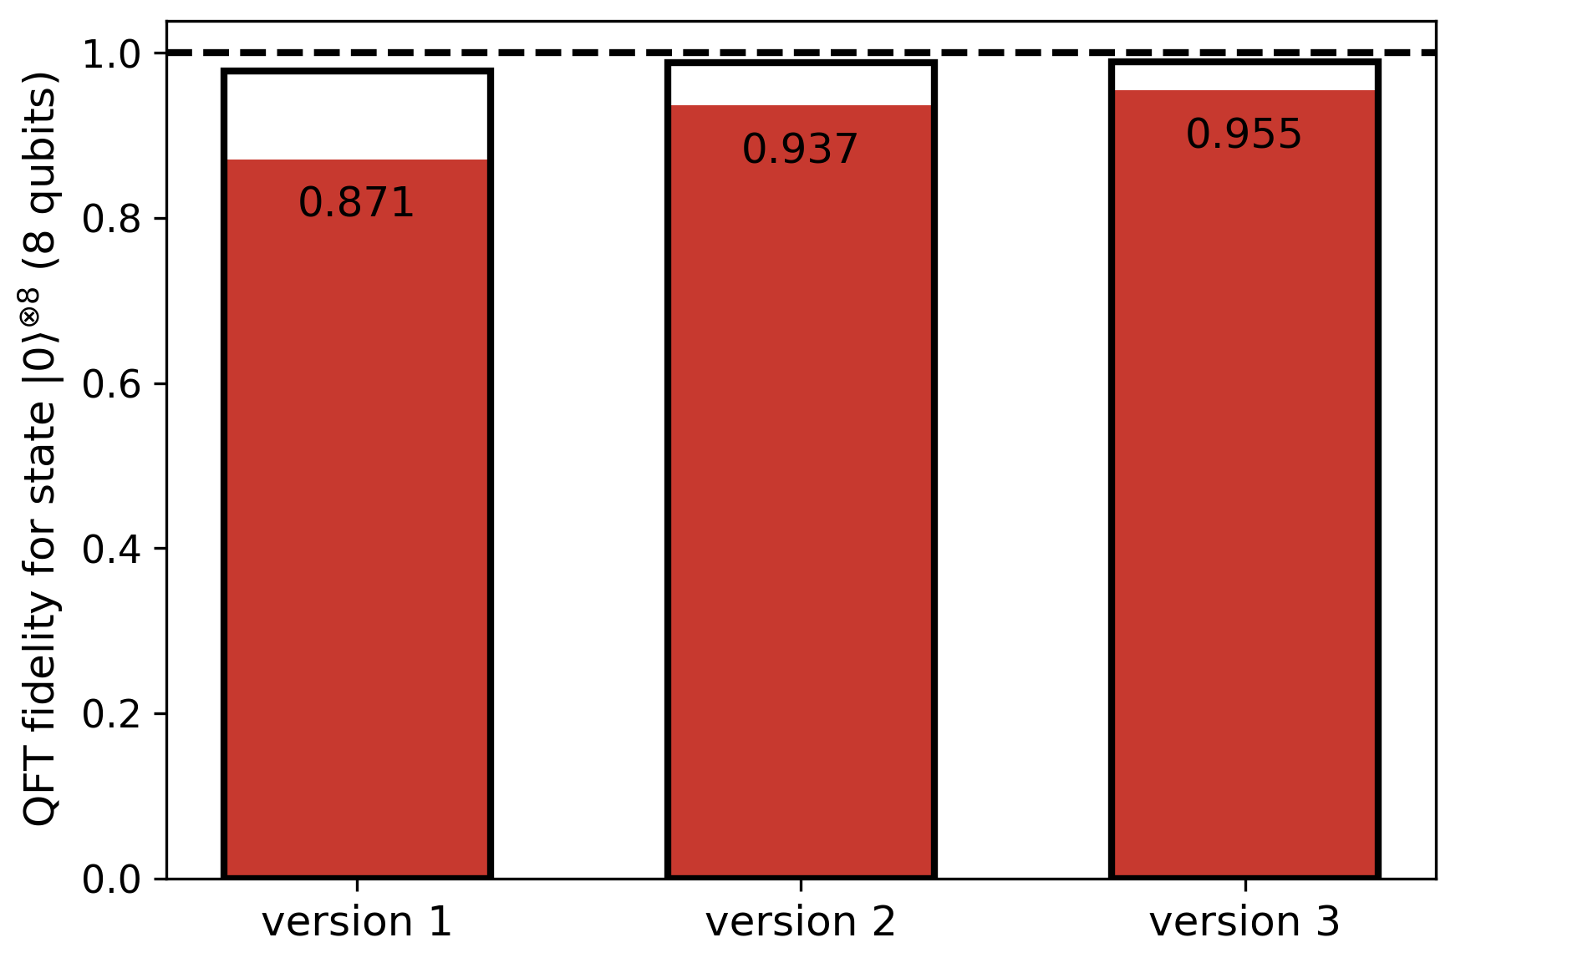
What we would like to achieve ...

Slide 3
QUANTUM FOURIER TRANSFORM

Slide 4
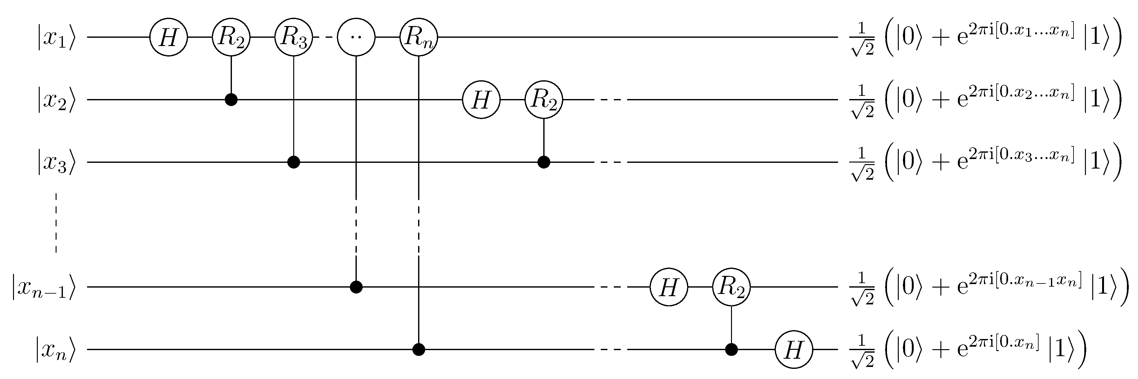
Quantum Fourier Transform Circuit
Hadamard Gate
CPhase Gate
Resource for Shor's Factoring Algorithm (1994) and Quantum Phase Estimation (A. Kitaev, 1995)!
[1] Nielsen, M. A., & Chuang, I. L. (2010). Quantum computation and quantum information (10th Anniversary ed.). Cambridge University Press.

Slide 5
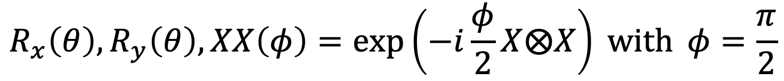
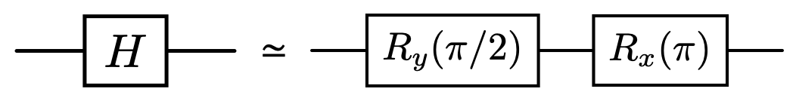

QFT with Trapped Ion Gate Set
Gate Set:
Decomposition of Hadamard Gate and Z-Rotation

Slide 6
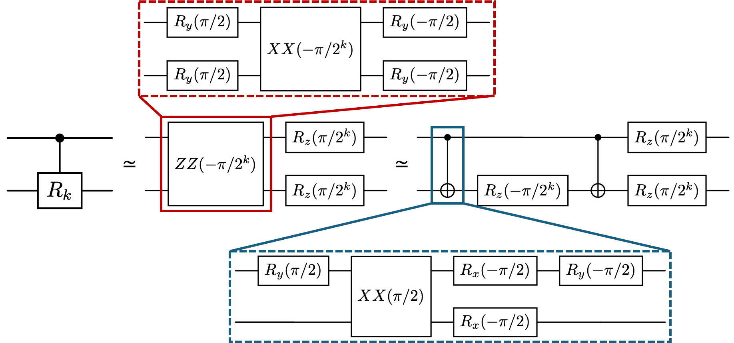
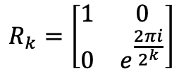
QFT with Trapped Ion Gate Set
Gate Set:

Slide 7
QFT with Trapped Ion Gate Set
Gate Set:

Slide 8
QFT with Trapped Ion Gate Set
Gate Set:

Slide 9
QFT with Trapped Ion Gate Set
Gate Set:
Only have access to maximally entangling Mølmer-Sørensen Gate !
XX-Rotation is fixed !

Slide 10
QFT with Trapped Ion Gate Set
Gate Set:
Only have access to maximally entangling Mølmer-Sørensen Gate !
XX-Rotation is fixed !

Slide 11
QFT with Trapped Ion Gate Set
Gate Set:
Only have access to maximally entangling Mølmer-Sørensen Gate!
XX-Rotation is fixed!
[2]
[2] Natalie C Brown et al 2019 New J. Phys. 21 073055

Slide 12
Full QFT Decomposition for Two Qubits

Slide 13
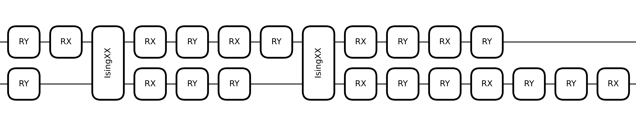
Full QFT Decomposition for Two Qubits
QFT fidelity without noise for 8 Qubits: 1.00000

Slide 14
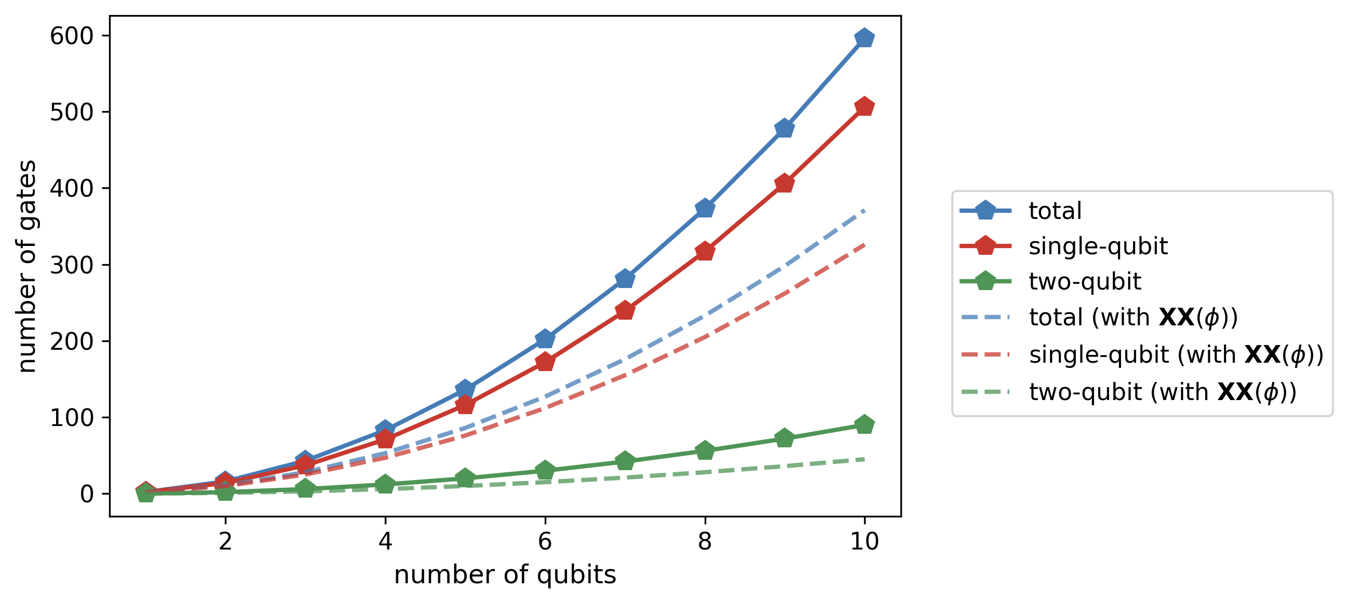
QFT Circuit Complexity
Gate count scales quadratically with number of qubits!
Lower gate count with continuous XX-rotations

Slide 15
VISUALIZATION

Slide 16
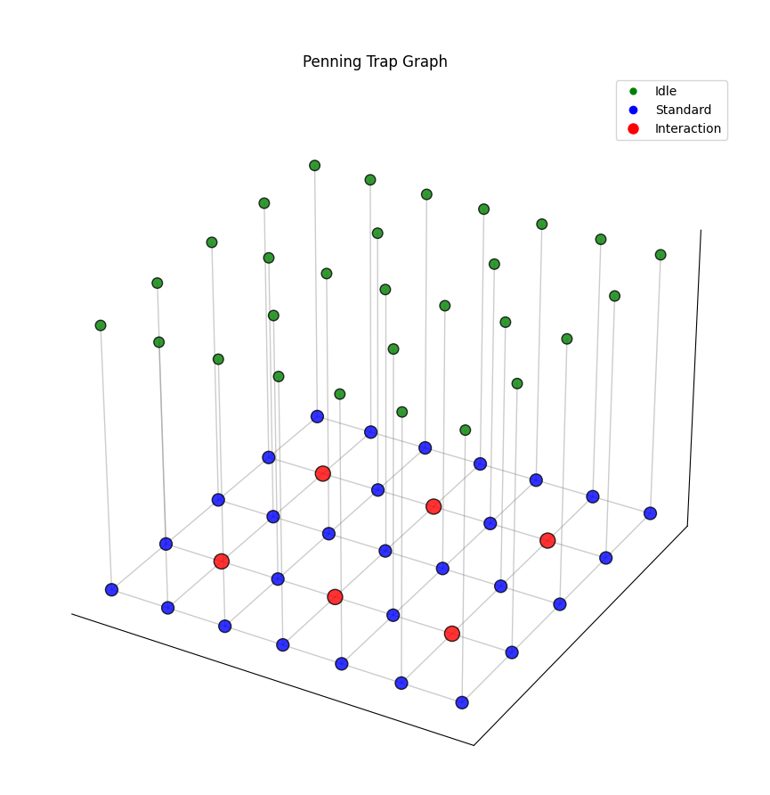
Visualization Idea

Slide 17
Visualization Idea
= interaction zone

Slide 18
2D grid

Slide 19
Add Ions

Slide 20
Move Ions

Slide 21
Idle Ions

Slide 22
Un-idle Ions

Slide 23
Two Qubit Gates

Slide 24
Move Ions

Slide 25
RESULTS

Slide 26
Compiler 01: Reuse Initial Position
Choose initial position.
What are the current gates?
1 qubit gate: Just do it.
2 qubit gate: Find closest interaction node.
Go back to initial position.
Repeat.

Slide 27
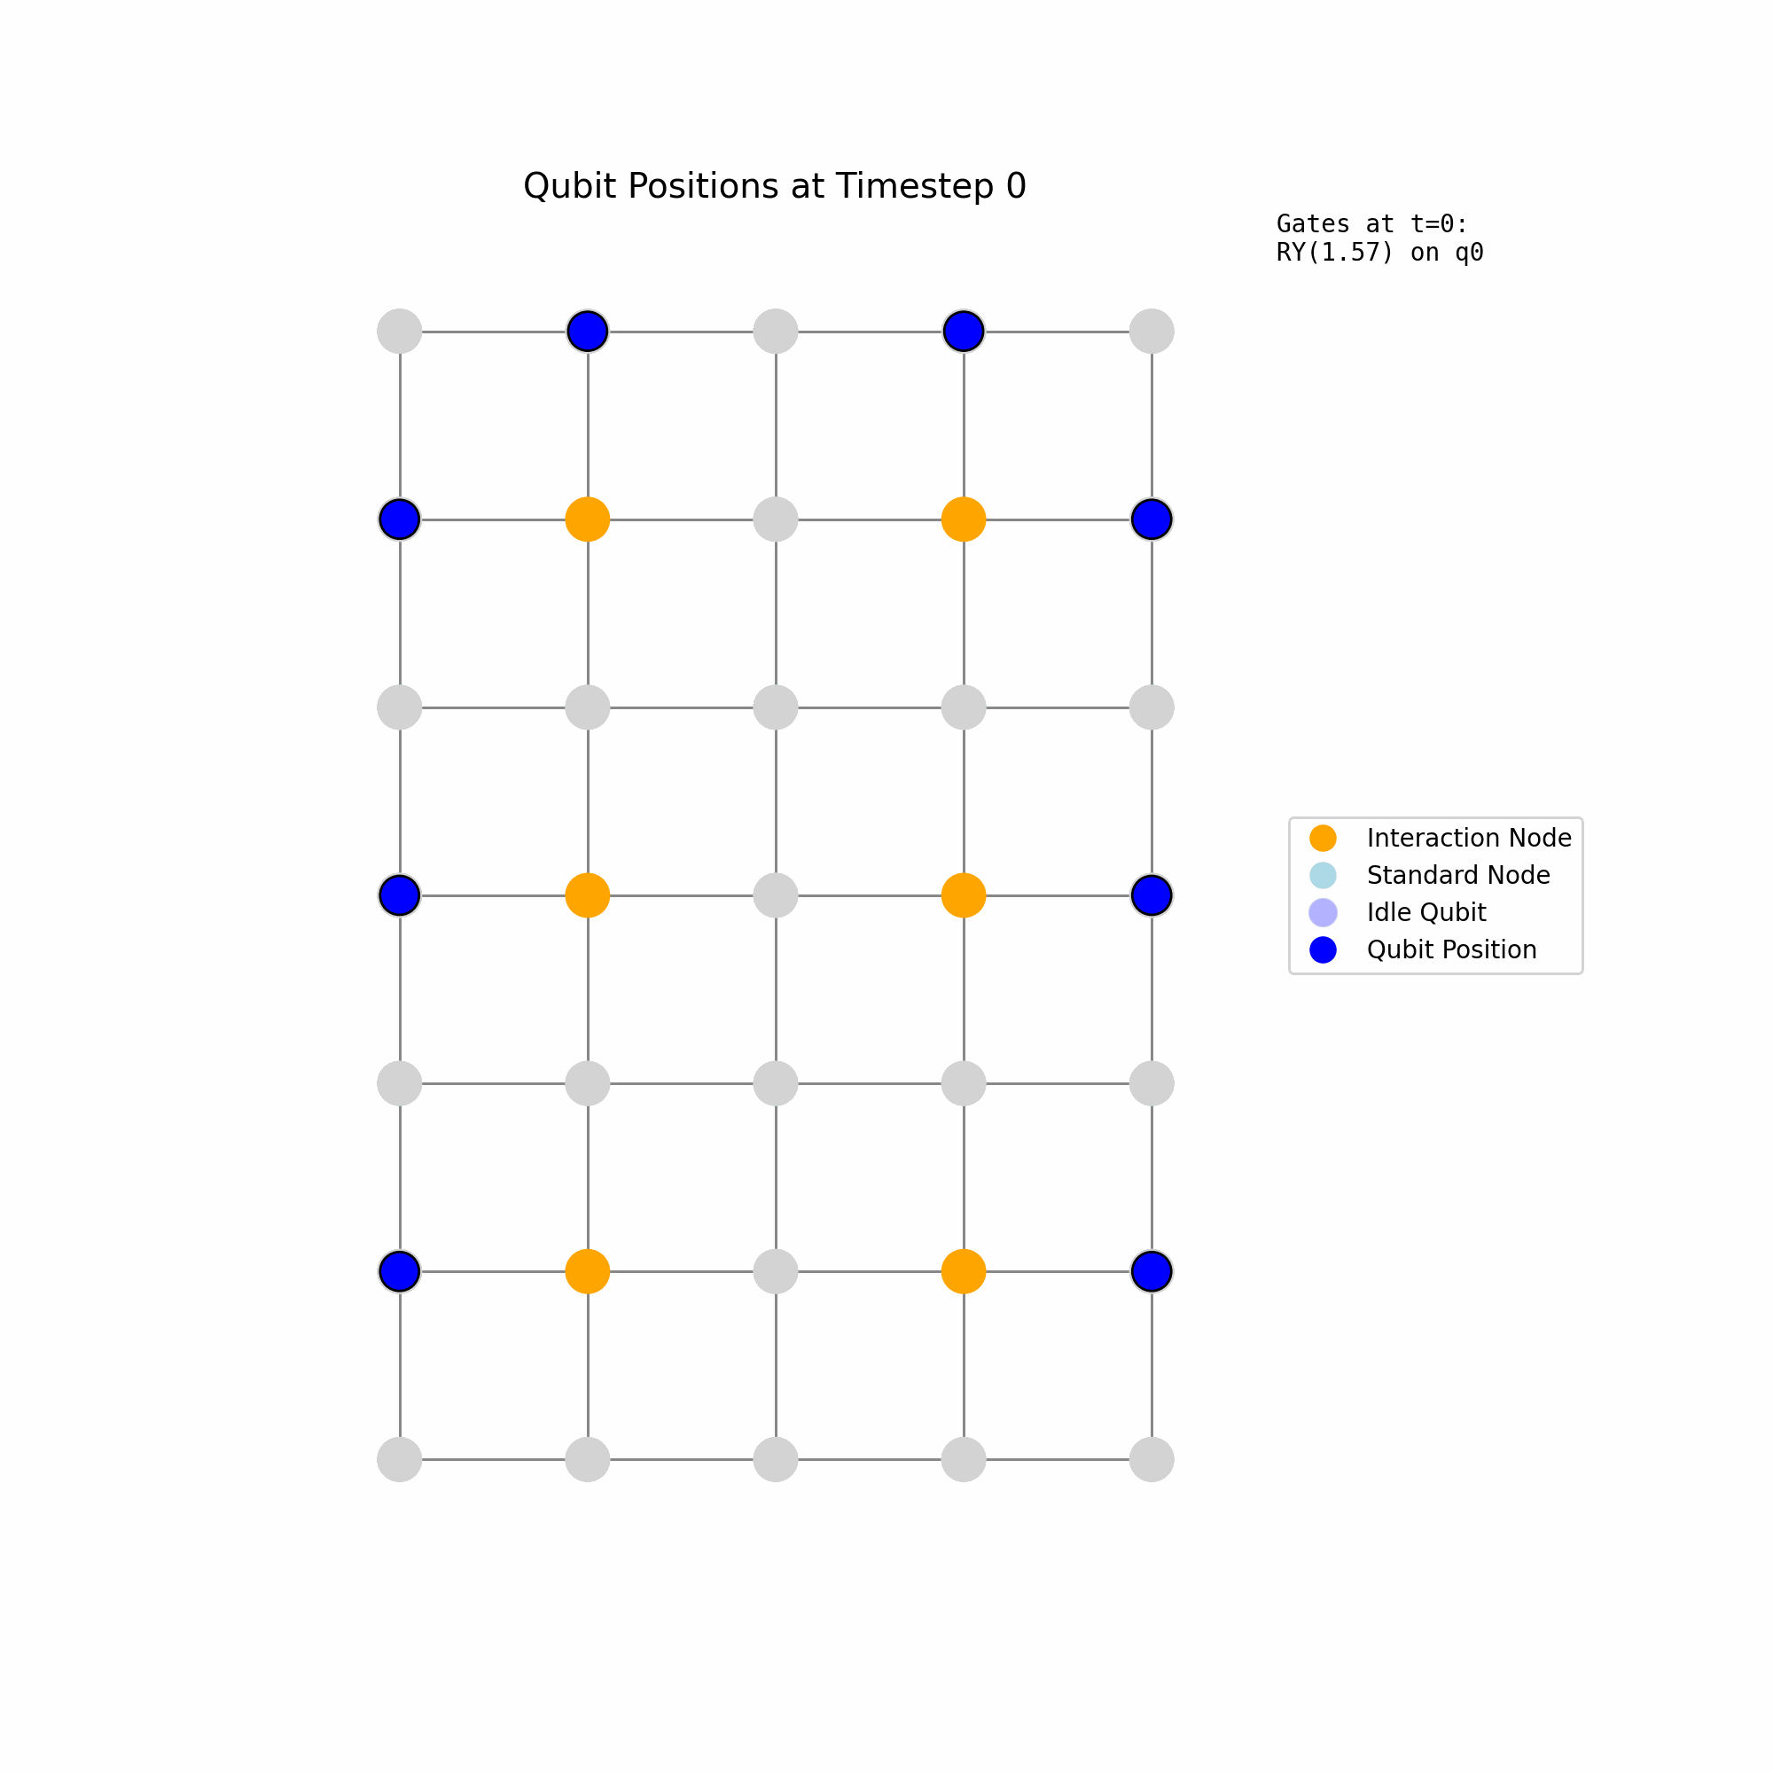
Compiler 01: Reuse Initial Position
Choose initial position.
What are the current gates?
1 qubit gate: Just do it.
2 qubit gate: Find closest interaction node.
Go back to initial position.
Repeat.

Slide 28
Compiler 02: Reuse Initial Position + Ion Idling
Call Compiler 01.
Postprocess output to determine idling periods.
If ion not moving AND no gates for 6 timesteps, idle.
WHY?
Reduced temperature cost at idle position
Idle time > threshold, movement is beneficial

Slide 29
Compiler 02: Reuse Initial Position + Ion Idling
Call Compiler 01.
Postprocess output to determine idling periods.
If ion not moving AND no gates for 6 timesteps, idle.
WHY?
Reduced temperature cost at idle position
Idle time > threshold, movement is beneficial

Slide 30
Compiler 03: Ion Repositioning + Ion Idling
Arrange ions initially in circle with increasing indices
Swap interacting ions at the interaction site (after their last interaction)
WHY?
Ions interact only with their neighbors
Minimizes shuttling steps

Slide 31
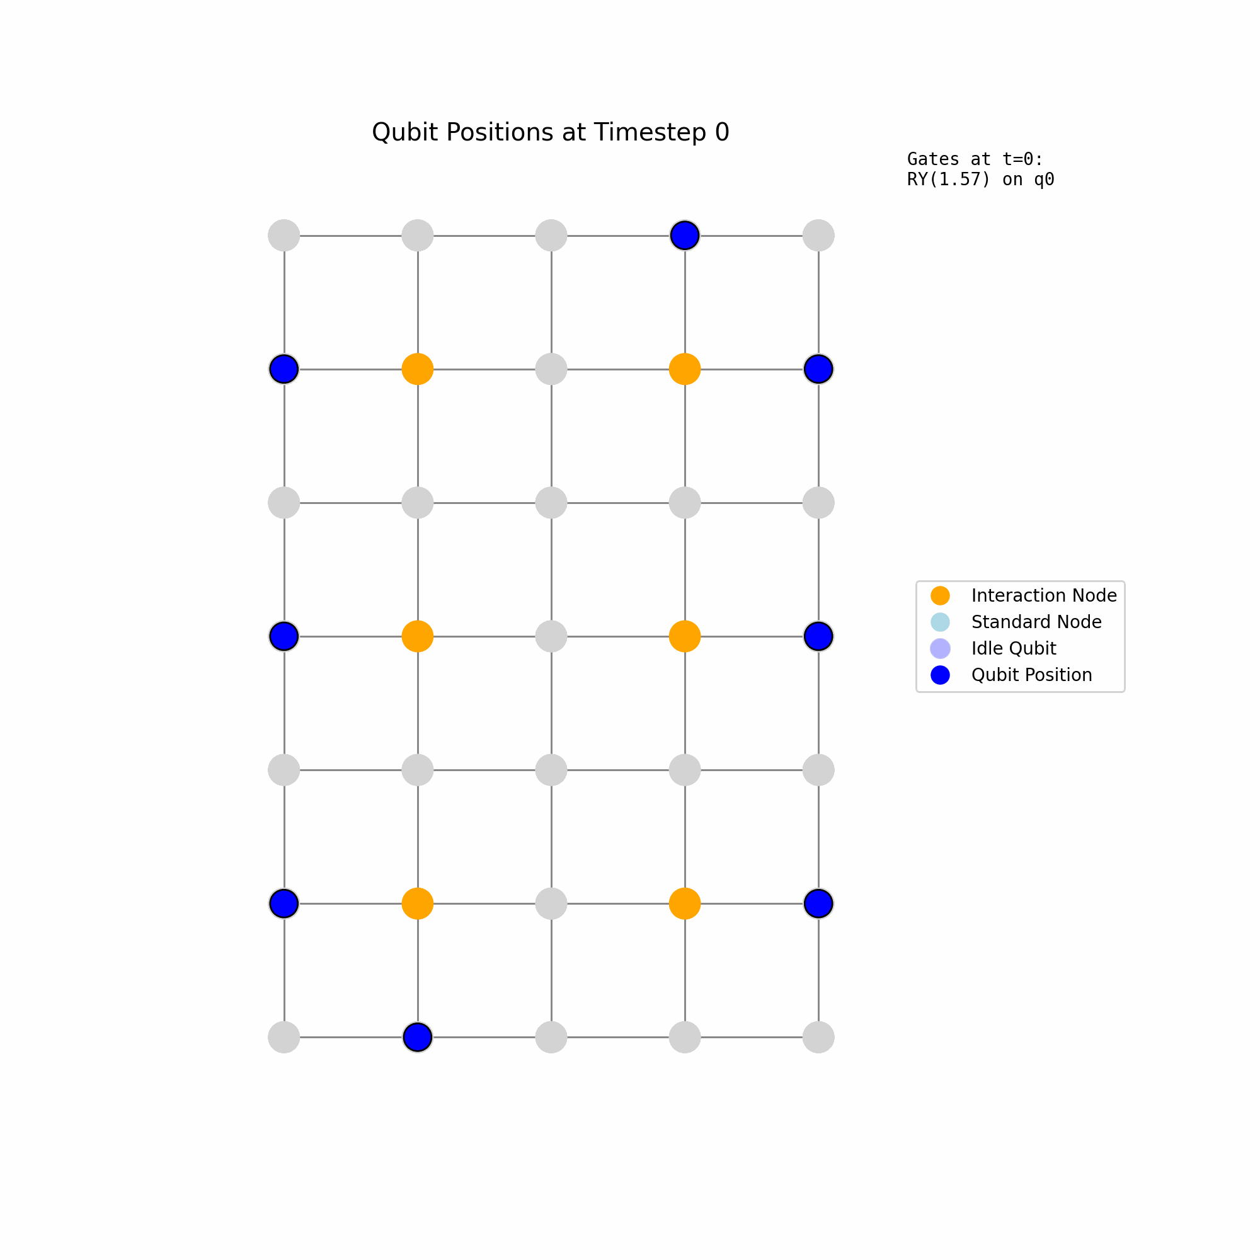
Compiler 03: Ion Repositioning + Ion Idling
Arrange ions initially in circle with increasing indices
Swap interacting ions at the interaction site (after their last interaction)
WHY?
Ions interact only with their neighbors
Minimizes shuttling steps

Slide 32

Fidelities of Compilers for 8 Qubits

Slide 33
CONCLUSION

Slide 34
Summary
Successfully decomposed QFT in native trapped ion gate set
Studied gate count scaling of decomposition
Developed three generations of compilers to map decomposed QFT circuit to penning trapped ion architecture:
Compiler 01: reuse initial condition
Fidelity: 0.871 (0.978 with dynamic XX-rotation)
Compiler 02: reuse initial condition + ion idling
Fidelity: 0.937 (0.988 with dynamic XX-rotation)
Compiler 03: ion repositioning + ion idling
Fidelity: 0.955 (0.989 with dynamic XX-rotation)

Slide 35
Thanks!

